Slide 1




$\frac{{dP}_{CHN}}{dt}=r_{CHN}{∙P}_{CHN}∙(1−\frac{P_{CHN}+α_{Effect}P_{IND}}{K_{CHN}}$)
$\frac{{dP}_{CHN}}{dt}=r_{CHN}{∙P}_{CHN}∙(1−\frac{P_{CHN}}{K_{CHN}}$)
$\frac{dP}{dt}=rP∙(1−\frac{P}{K}$) $∙(1−\frac{P}{A}$)
$\frac{{dP}_{IND}}{dt}=r_{IND}{∙P}_{IND}∙(1−\frac{P_{IND}}{K_{IND}}$)

Slide 2
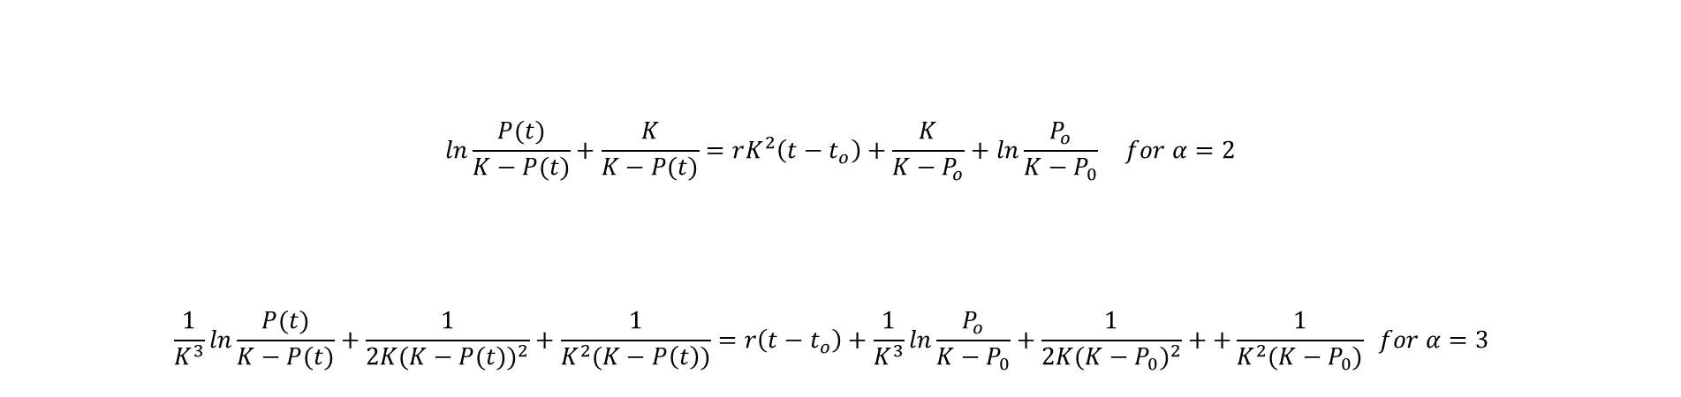
$$ln\frac{P(t)}{K−P(t)}+\frac{K}{K−P(t)}=rK^{2}\left(t−t_{o}\right)+\frac{K}{K−P_{o}}+ln\frac{P_{o}}{K−P_{0}} for α=2$$
$$\frac{1}{K^{3}}ln\frac{P(t)}{K−P(t)}+\frac{1}{2K{(K−P(t))}^{2}}+\frac{1}{K^{2}(K−P\left(t\right))}=r\left(t−t_{o}\right)+\frac{1}{K^{3}}ln\frac{P_{o}}{K−P_{0}}+\frac{1}{2K{(K−P_{0})}^{2}}++\frac{1}{K^{2}(K−P_{0})} for α=3$$
Yao-Zheng’s Solutions of her Power Exponent Model , $\frac{dP(t)}{dt}=rP{(t)∙(K−P(t))}^{α}$

Slide 3




















$$y(x_{0})$$
$$y(x_{0}+h)$$
$$y(x_{0}+2h)$$
$$y(x_{0}+3k)$$
$$y(x_{0}+\left(k−1\right)h)$$
$$y(x_{0}+kh)$$
$$G(y\left(x_{0}\right))$$
$$G(y\left(x_{0}+h\right))$$
$$G(y\left(x_{0}+2h\right))$$
$$G(y\left(x_{0}+3h\right))$$
$$G(y\left(x_{0}+\left(k−1\right)h\right))$$
$$y′(x_{0})$$
$$y′(x_{0}+h)$$
$$y′(x_{0}+2h)$$
$$y′(x_{0}+3h)$$
$$y′(x_{0}+\left(k−1\right)h)$$
$$A$$
$$C$$
$$where:$$
$$means C=A+B×h$$
B

Slide 4





















$Step$3
$$y^{(0)}\left(x_{0}\right)$$
$$y^{(0)}\left(x_{0}+h\right)$$
$$y^{(0)}\left(x_{0}\right)$$
$$Step 2$$
$Step$1
$$y^{(1)}\left(x_{0}\right)$$
$$y^{(1)}\left(x_{0}\right)$$
$$y^{(1)}\left(x_{0}+h\right)$$
G function
G function
$$y^{(n−3)}\left(x_{0}\right)$$
$$y^{(n−3)}\left(x_{0}+h\right)$$
$$y^{(n−3)}\left(x_{0}\right)$$
$$y^{(n−2)}\left(x_{0}\right)$$
$$y^{(n−2)}\left(x_{0}+h\right)$$
$$y^{(n−2)}\left(x_{0}\right)$$
$$y^{(n−1)}\left(x_{0}\right)$$
$$y^{(n−1)}\left(x_{0}+h\right)$$
$$y^{(n−1)}\left(x_{0}\right)$$
$$y^{(n−1)}\left(x_{0}\right)$$
$$y^{(n−1)}\left(x_{0}\right)$$

Slide 5
Yao-Zheng’s Solutions of Power Exponent Model , $\frac{dP(t)}{dt}=rP{(t)∙(K−P(t))}^{α}$
$$ln\frac{P(t)}{K−P(t)}+\frac{K}{K−P(t)}=rK^{2}\left(t−t_{o}\right)+\frac{K}{K−P_{o}}+ln\frac{P_{o}}{K−P_{0}} for α=2$$
$$\frac{1}{K^{3}}ln\frac{P(t)}{K−P(t)}+\frac{1}{2K{(K−P(t))}^{2}}+\frac{1}{K^{2}(K−P\left(t\right))}=r\left(t−t_{o}\right)+\frac{1}{K^{3}}ln\frac{P_{o}}{K−P_{0}}+\frac{1}{2K{(K−P_{0})}^{2}}++\frac{1}{K^{2}(K−P_{0})} for α=3$$

Slide 6
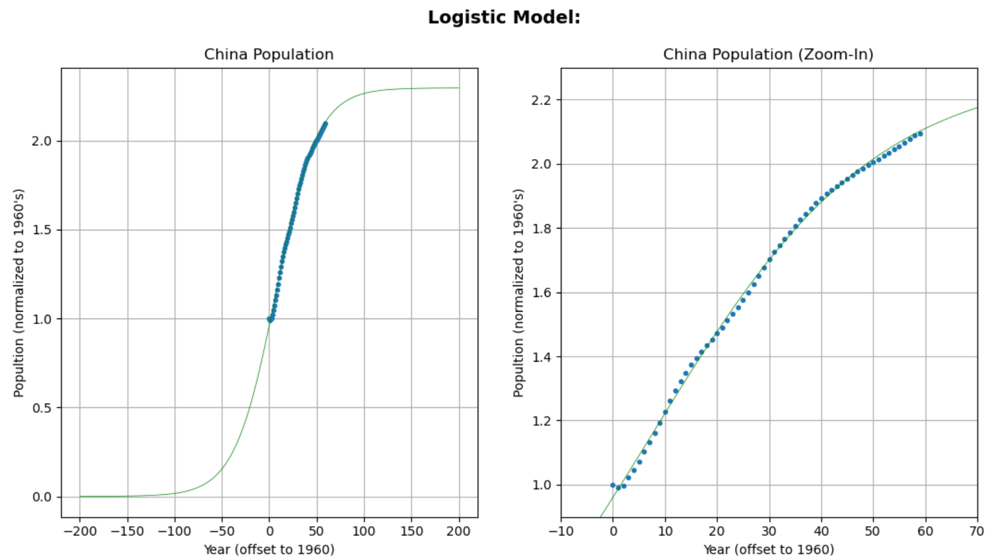

Slide 7
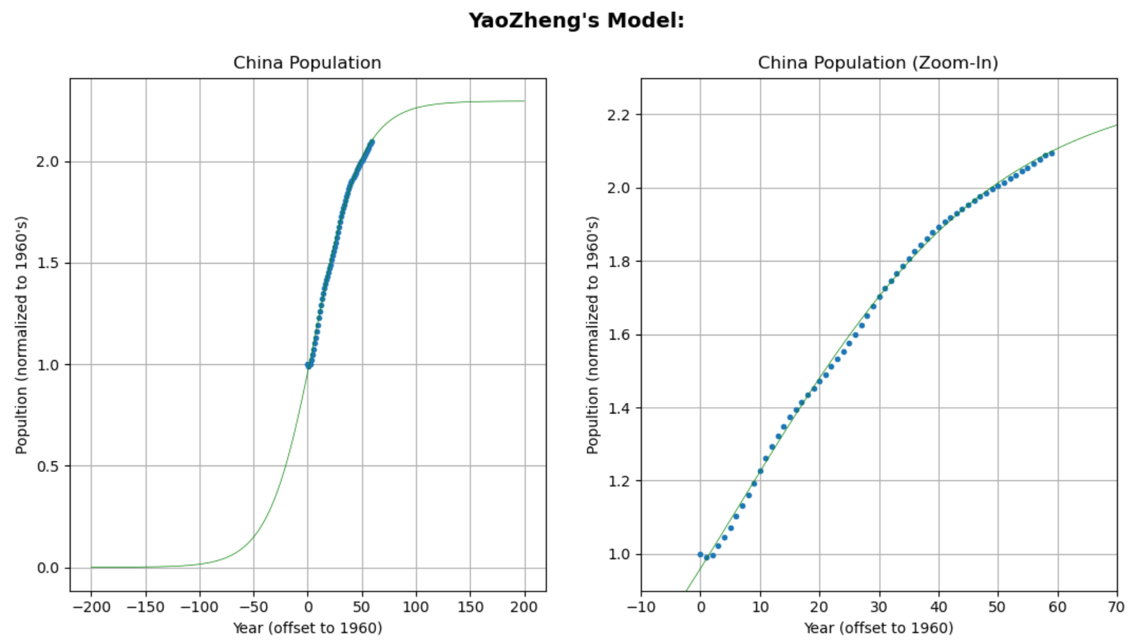

Slide 8
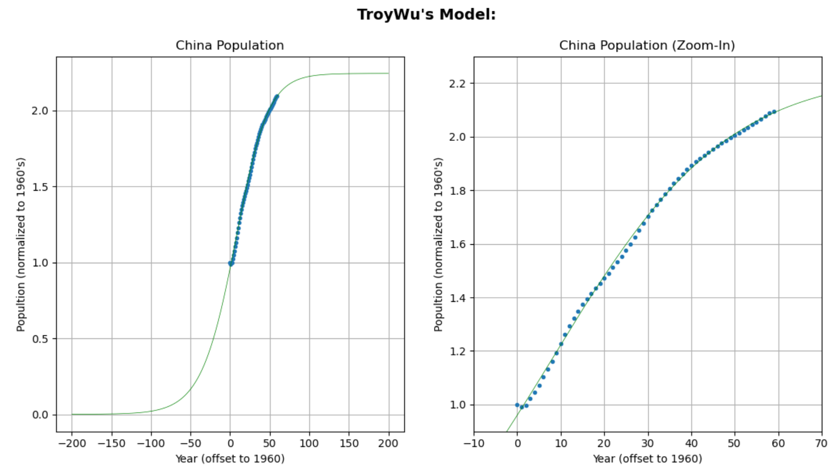

Slide 9
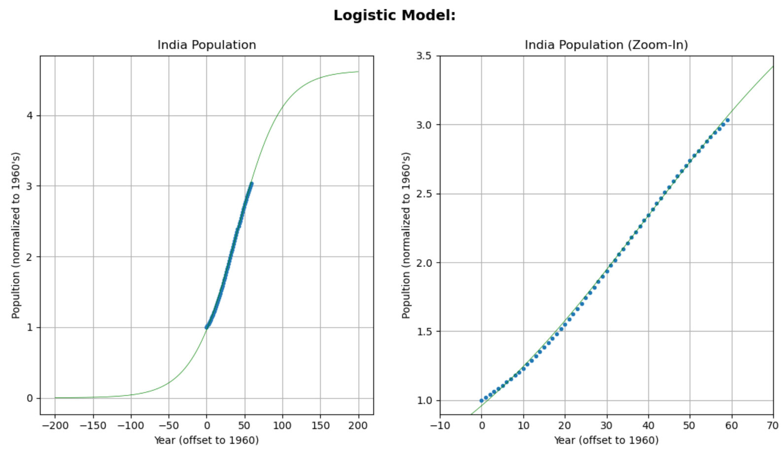

Slide 10
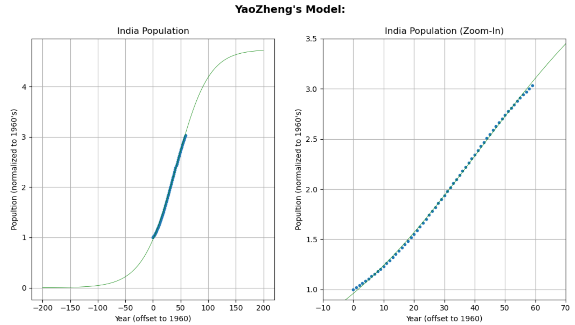

Slide 11
